Slide 1
80286 Microprocessor
Farhan Sadaf
Lecturer, Dept. of CSE

Slide 2
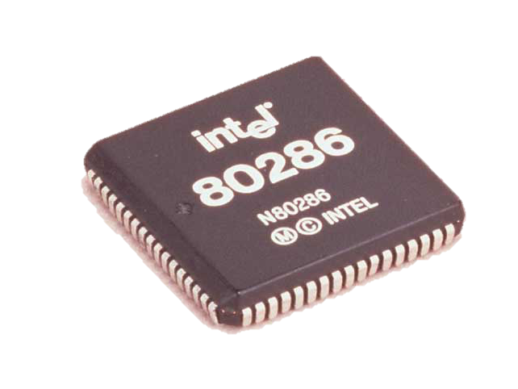
Introduction
The needs of a multitasking/multiuser operating system include:
Environment preservation during task switches.
Operating system and user protections.
Virtual memory management.
The Intel 80286 was one of the first 8086 family processor designed to make implementation of these features relatively easy.

Slide 3
Intel family of microprocessor, bus and memory sizes
Microprocessor | Data bus width | Address bus width | Memory size
8086 | 16 | 20 | 1M
80186 | 16 | 20 | 1M
80286 | 16 | 24 | 16M
80386 DX | 32 | 32 | 4G
80486 | 32 | 32 | 4G
Pentium 4 & core 2 | 64 | 40 | 1T

Slide 4
Salient features of 80286
80286 is one of the first member of the family of advanced microprocessors with memory management, virtual memory management and protection abilities.
The 80286 CPU, with its 24-bit address bus is able to address 16Mb of physical memory.
Available in 12.5Mhz, 10MHz & 8Mhz clock frequencies.

Slide 5
Memory management is supported by a hardware unit called Memory management unit.
Intel’s 80286 is the first CPU to incorporate the Integrated memory management unit.
Function of memory management unit :
Ensure smooth execution of the program.
Protection.

Slide 6
SWAPPING IN :
From secondary memory to physical memory
SWAPPING OUT :
From physical memory to secondary memory
Important aspect of memory management is Data Protection or unauthorized access prevention.
Done with the help of segmented memory.
Prevents overlapping of segments to avoid random result.

Slide 7
Functional Parts
Address unit (AU)
Bus unit (BU)
Instruction unit (IU)
Execution unit (EU)

Slide 8
Address Unit
Calculate the physical addresses of the instruction and data that the CPU want to access.
Address lines derived by this unit may be used to address different peripherals.
Physical address computed by the address unit is handed over to the BUS unit.
Bus Unit
Transmit the physical address over address bus A₀ – A_{23.}
Instruction Pipelining.
Prefetcher module in the bus unit performs this task of prefetching.
Bus controller controls the prefetcher module.
Fetched instructions are arranged in a 6 – byte prefetch queue.
Processor Extension Interface Module – Take care of communication b/w CPU and a coprocessor.

Slide 9
3. Instruction Unit
Receive arranged instructions from 6 byte prefetch queue.
Instruction decoder decodes the instruction one by one and are latched onto a decoded instruction queue.
Output of the decoding circuit drives a control circuit in the Execution unit.
4. Execution unit
Control unit is responsible for executing the instructions received from the decoded instruction queue.
Contains Register Bank.
ALU is the heart of execution unit.
After execution ALU sends the result either over data bus or back to the register bank.

Slide 10
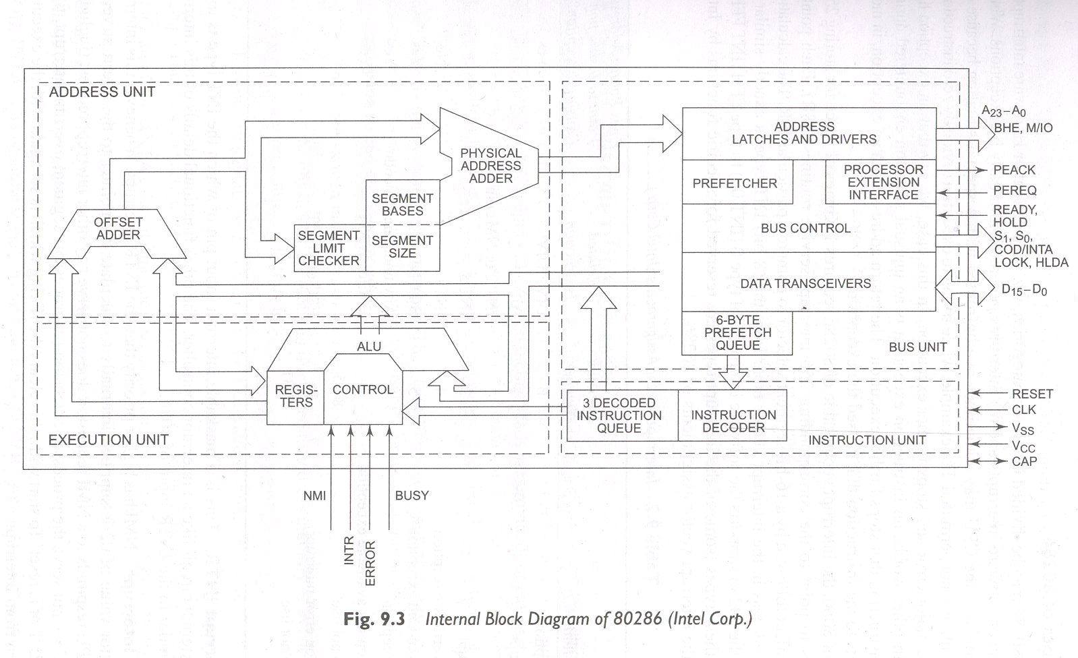
Internal Block Diagram of 80286

Slide 11
Operating Modes
Intel 80286 has 2 operating modes.
Real address mode.
Protected Virtual address mode.
Real Address Mode :
80286 just as a fast 8086
All memory management and protection mechanisms are disabled
Protected Virtual Address Mode
80286 works with all of its memory management and protection capabilities with the advanced instruction set.

Slide 12
Real address mode
In real address mode, address unit of the 80286 computes address using a segment base and offset just as the 8086 does.
The familiar CS, DS, ES and SS registers are used to hold the base address for the segments currently in use.
The maximum physical address in this mode is 1 Mbyte just as it is for the 8086.

Slide 13
Protected address mode
If an 80286 is operating in its protected virtual address mode, the address unit functions as a complete MMU.
In this address mode the 80286 uses all 24 address lines to access up to 16 Mbytes of physical memory.
In protected mode it also provides up to a gigabyte of virtual memory using the descriptor table scheme.

Slide 14
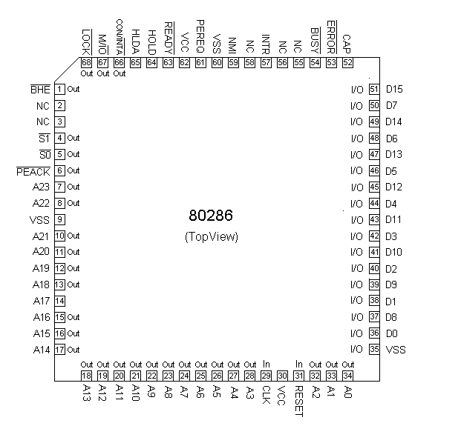
80286 pins

Slide 15
80286 pins
The 80286 has a 16-bit data and a 24-bit address non multiplexed address bus.
The 24 bit address bus allows the processor to access 16 Mbytes of physical memory when operating in protected mode.
Memory hardware for 80286 is set up as an odd bank and an even bank, just as 8086.
The even bank will be enabled when A0 is low and odd bank is enabled when BHE is low.
To access an aligned word both A0 and BHE will be low.

Slide 16
80286 pins
The 80286 functions similarly to an 8086 operating in maximum mode.
Status signal SO, SI and M/IO are decoded by an external 82288 bus controller to produce the control bus, read, write and interrupt-acknowledge signals.
The HOLD, HLDA, INTR, INTA, READY, LOCK and RESET pins function basically the same as they do on an 8086.
An external 82284 clock generator is used to produce a clock signal for the 80286 and to synchronize RESET and READY signals.

Slide 17
80286 pins
The processor extension request (PEREQ) input will be asserted by a coprocessor to tell the 80286 to perform a data transfer to or from memory for it.
When the 80286 gets around to do the data transfer , it asserts the processor extension acknowledge (PEACK) signal to the coprocessor to let it know the data transfer has started.
Data transfers are done through the 80286 in this way so that the coprocessor uses the protection and virtual memory capability of the MMU in the 80286.

Slide 18
80286 pins
The BUSY signal input on the 80286 functions the same as the TEST1 input does on the 8086.
When the 80286 executes a WAIT instruction, it will remain in a WAIT loop until it finds the BUSY signal from the coprocessor high.
If a coprocessor finds some error during processing, it will assert the ERROR input of the 80286.
This will cause the 80286 to automatically do a type 16H interrupt call.
An interrupt service procedure can be written to make the desired response to the error condition.

Slide 19
80286 real address mode operation
After the 80286 is reset, it starts executing in real address mode.
This mode is referred to as real because physical memory addresses are produced by directly adding an offset to a segment base, just as they are in an 8086.
In this mode the 80286 can address up to 1 Mbyte of physical memory and functions essentially as a “souped-up” 8086.
In real address mode, the interrupt vector table of the 80286 is located in the first 1 Kbyte of memory, just as it is for an 8086 and the response to an interrupt is the same as that of an 8086.

Slide 20
80286 interrupt
80286 has several built-in interrupt types.
The 80186 and later processors separate interrupts into two categories:
Interrupts.
Exceptions.
Interrupt: Asynchronous external events which affect the processor through the INTR or NMI input are referred to as interrupts.
Exception: An exception type interrupt is generated by some error condition that occurred during the execution of an instruction.
Dividing by zero is an example of an operation that will cause an exception.
Software interrupts produced by the INT n instructions are classified as exceptions.

Slide 21
80286 protected mode operation
The first step in switching an 80286 to protected mode is to set the Protection Enable (PE) bit in the Machine Status Word (MSW) register in the 80286.
To change bits in the MSW, load the desired word in a register or memory location and execute the load machine status word (LMSW) instruction.
The final step is to get the 80286 operating in protected mode is to execute an intersegment jump to the start of the main system program.
This jump is necessary to flush the instruction byte queue because in protected mode the queue function differently form the way it does in real mode.
Switching an 80286 to protected mode enables the integrated MMU to provide virtual memory and protection.

Slide 22

MSW (Machine Status Word)
PE - Protection Enable MP - Monitor Processor Extension EM - Emulate Processor Extension TS - Task Switch

Slide 23
80286 protected mode operation
80286 virtual address consists of a 16-bit selector and a 16-bit offset.
The MMU uses 14 bits of the selector to access a descriptor for the desired segment in a table of descriptors.
The descriptor contains the 24-bit physical base address, the privilege level and some control bits for the segment.
If the privilege level contained in the selector is as high as or higher than the privilege level contained in the descriptor, then access to the segment will be allowed.
Notes:
Privilege levels in operating systems refer to different levels of access and permissions that are assigned to different processes or users. Most modern operating systems use four privilege levels, ranging from level 0, which is the most privileged, to level 3, which is the least privileged. In these systems, level 0 is typically reserved for the kernel or executive, while level 3 is used for application programs.

Slide 24
80286 protected mode operation
If not, an exception will be generated.
The MMU also checks the “P” bit in the descriptor to determine if the segment is present in physical memory.
If not the MMU will generate a segment-not-present exception.
The service procedure for this exception will load the segment in memory and return to the interrupted program.
If the memory access meets the privilege level test and the segment is present in physical memory, the MMU will add the 16-bit offset from the logical address to the 24-bit base address from the descriptor to produce the 24-bit physical address for the desired byte or word in the segment.

Slide 25
80286 protected mode operation
Once an 80286 is switched into protected mode by executing the LMSW instruction, the only way to get an 80286 back to its real address mode is by resetting the system
The 80286 was designed in this way so that a clever programmer could not switch the system back into real address mode to defeat the protection schemes in protected mode.

Slide 26
Limitation of 80286
It has only a 16-bit ALU.
Maximum segment size is 64 Kbytes.
It can’t easily be switched back and forth between real and protected modes.

Slide 27
Thank You

